Slide 1
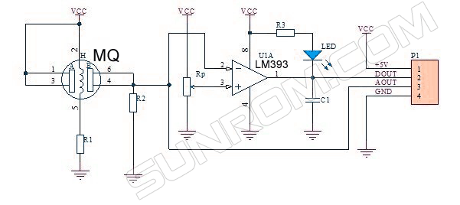
LAB safety system – MQ2 Gas Sensor Pinout

Slide 2

LAB safety system – MQ2 Gas Sensor Pinout

Slide 3
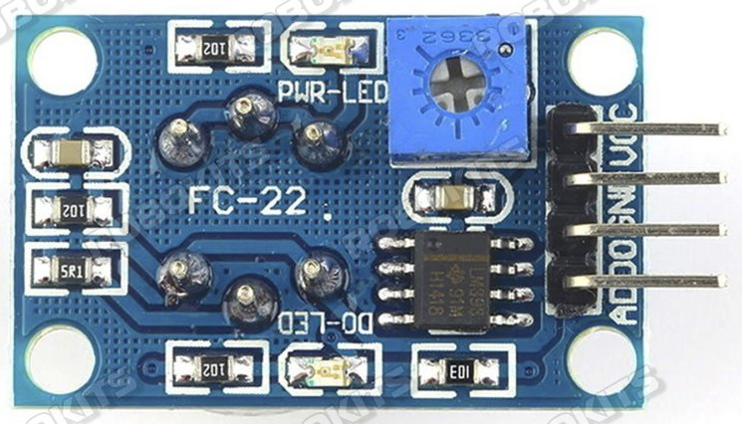
LAB safety system – MQ2 Gas Sensor Pinout

